Slide 1
Small Group Communication:
Issue Exploration/Proposal: Parking Lot Surveillance
Term Project
Chris Lowery, Ryan McColloch, Durbie McReynolds, Shellby Nebocat, Maggie Newell

Slide 2
Pitt-State Parking lot surveillance
What's the issue?
Who cares?

Slide 3
Problem analysis and research
Pittsburg State crime rates
Pitt student interview
Off campus living comparison
Basehor, KS high school comparison
Jennifer Lowery interview

Slide 4
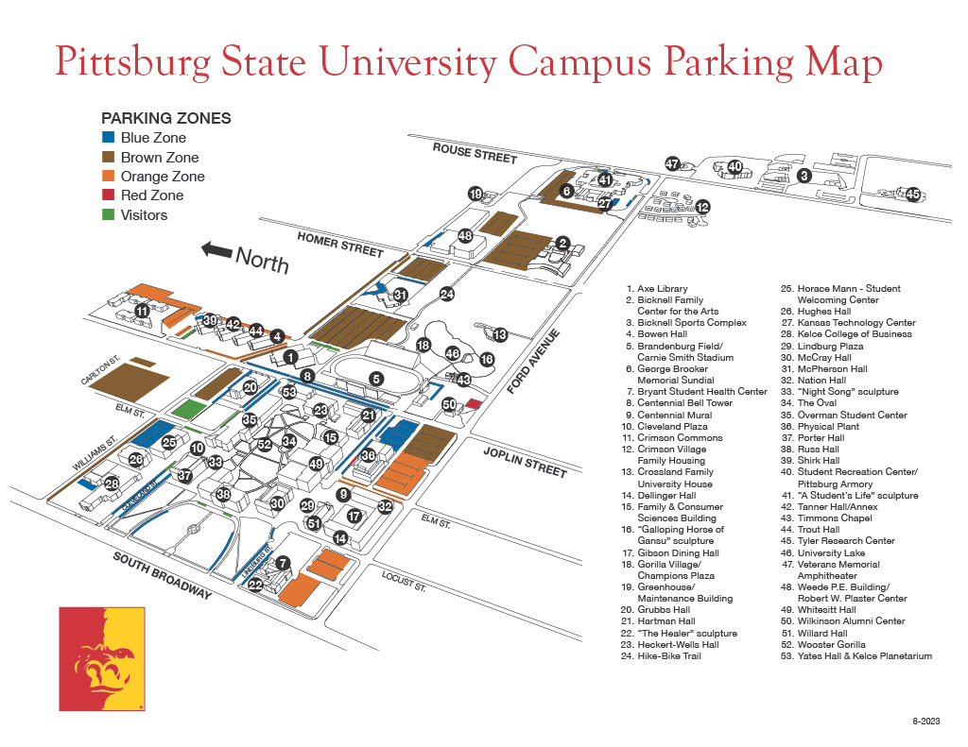
Blue: Faculty and staff. Valid in Blue and Brown zones.
Brown: Faculty, staff, and students.
Orange: Students with on-campus housing in Bowen, Trout, Tanner, Nation, Dellinger, and Crimson Commons. Valid in both Orange and Brown zones.
Visitor: Does not require a permit.
Motorcycle: Faculty, staff, and students

Slide 5
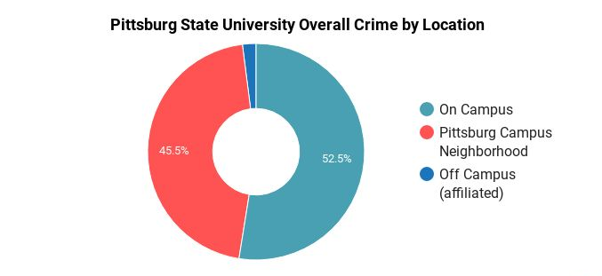
52
TOTAL NUMBER OF INCIDENTS RELATED TO CRIME AND SAFETY
7.83
INCIDENTS PER 1000 STUDENTS

Slide 6
Interview with Audrey Marney
Nation hall
License plate
No report
No solution

Slide 7
Off Campus Comparison
The Edge
Crimson Villas
The Block22
Summerfield

Slide 8
Interview with Jennifer Lowery
Instructor in Basehor, KS area
  Comparable socioeconomic status
  Viable, affordable solutions
  Anti-theft methods successful

Slide 9
Basehor Middle/High School’s Theft Response
No cameras in HS parking lot =/= increase in theft
In-school security feed “unruly” & underutilized
Downsides to camera-based security
Increased in-person security successful

Slide 10
Possible solutions
More Lighting
More security patrolling
Optimizing parking space layout
Advance security cameras (LotGuard)

Slide 11
Solution implementation
Advanced Security Cameras (Lot Guard)
Installation
Maintain
Monitor
Arrest made

Slide 12
Conclusion
Complex issue requiring complex solution
LotGuard as a solution to security footage pratfalls
Marked increase in quality of student life

Slide 13
Small Group Communication:
Group observation
Term Project

Slide 14
Elements of Group Culture
Primary Tension: primary hurdle to overcome
Secondary Tension: insubstantial
Ascribed Status: nonexistent
Earned Status: unofficial leader status

Slide 15
Group Socialization
Antecedent Phase: Initial awkwardness
Anticipatory Phase: Learning our strengths/weaknesses
Encounter Phase: Taking initiative
Assimilation Phase: The ball’s finally rolling
Exit Phase: In-progress!

Slide 16
Group decision making
Exploring our options
Deciding on a topic
Finding areas for improvement
Insights from interviews
Solutions and implementations

Slide 17
Fantasy Chains
Topics included football, school breaks, and previous classes
All relaxed but new to group
Majority of the time on topic

Slide 18
Leadership
Early on
Individual Leadership
Organization

Slide 19
Cohesiveness
Social cohesion
- Fantasy chains
- No argumentative issues
Task cohesion
- group think
- deadlines
- late start

Slide 20
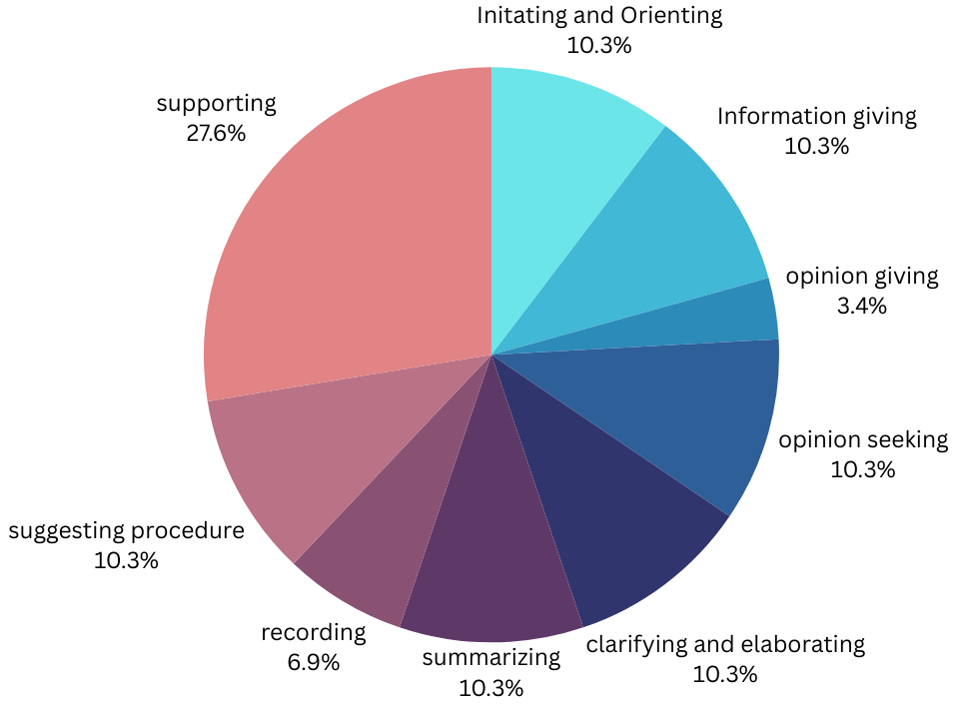
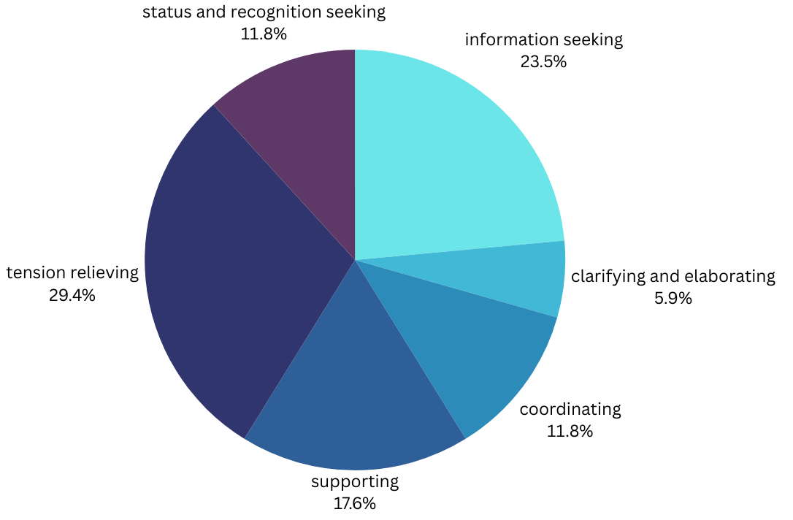
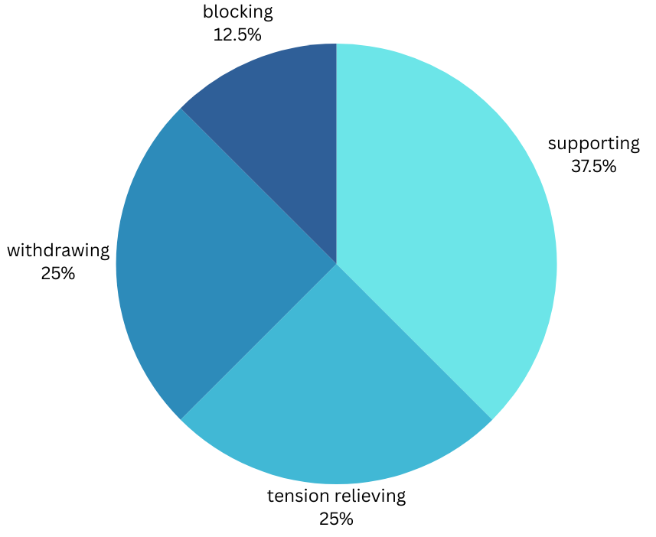
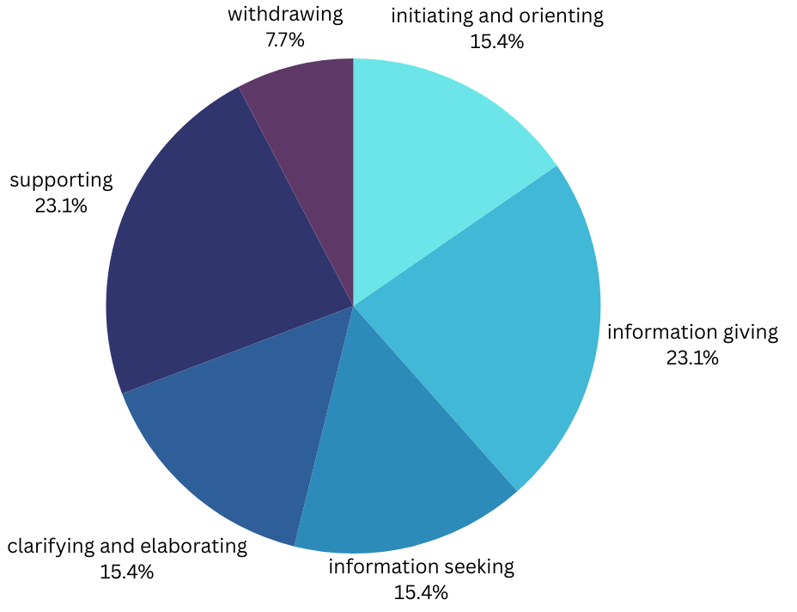
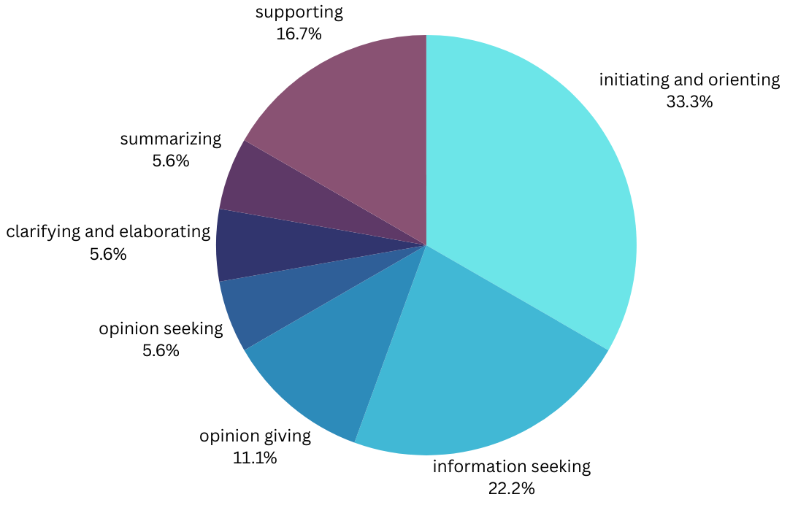
Beginning behavioral function charts
Ryan
Durbie
Chris
Shellby
Maggie

Slide 21
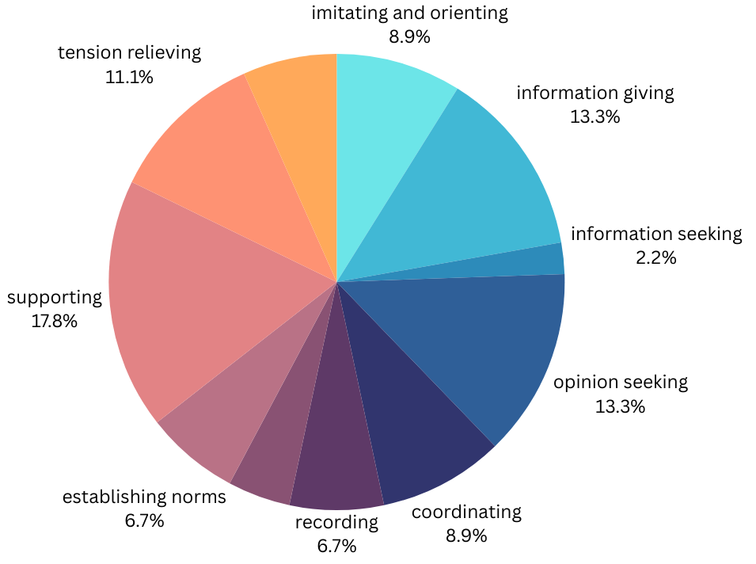
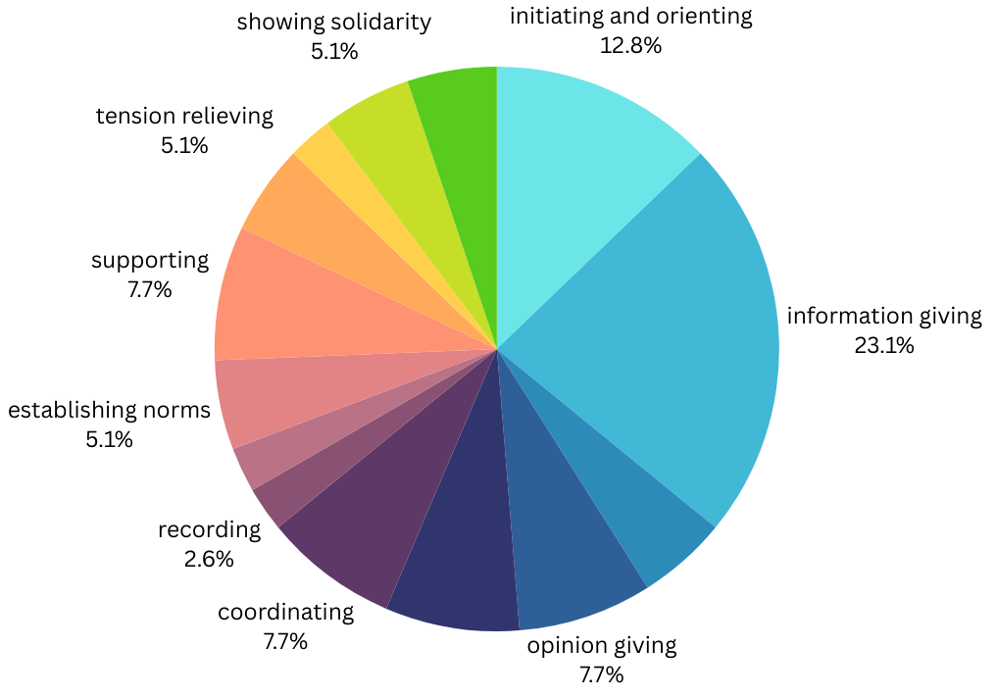
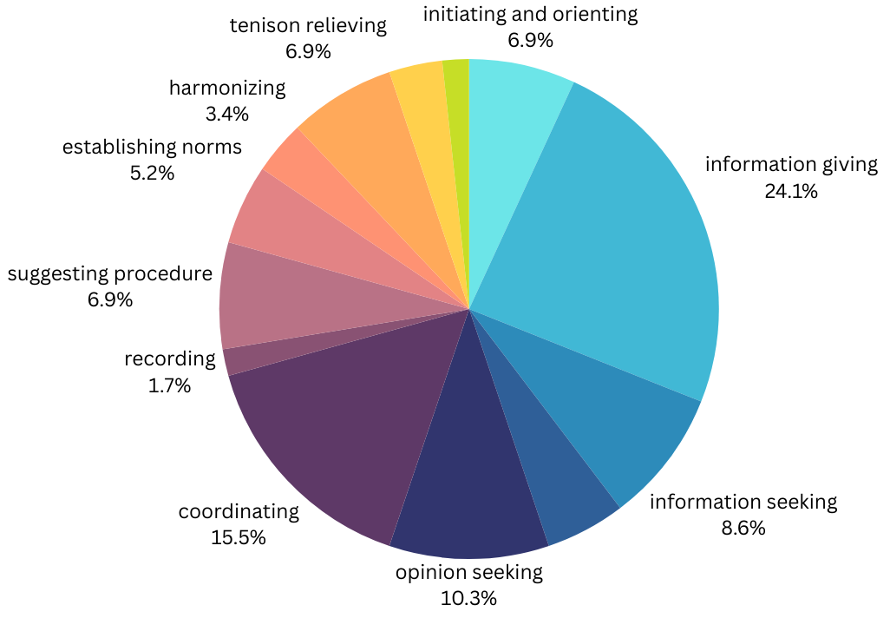
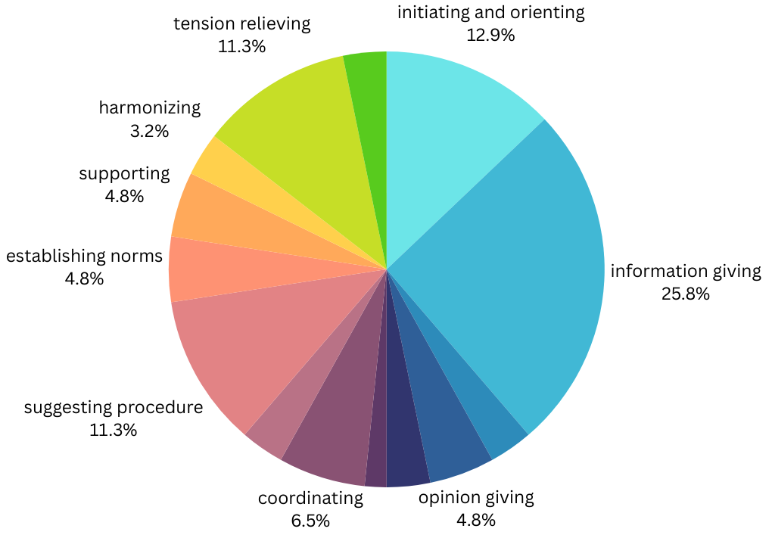
Middle behavioral function charts
Ryan-
Absent
Chris
Durbie
Shellby
Maggie

Slide 22
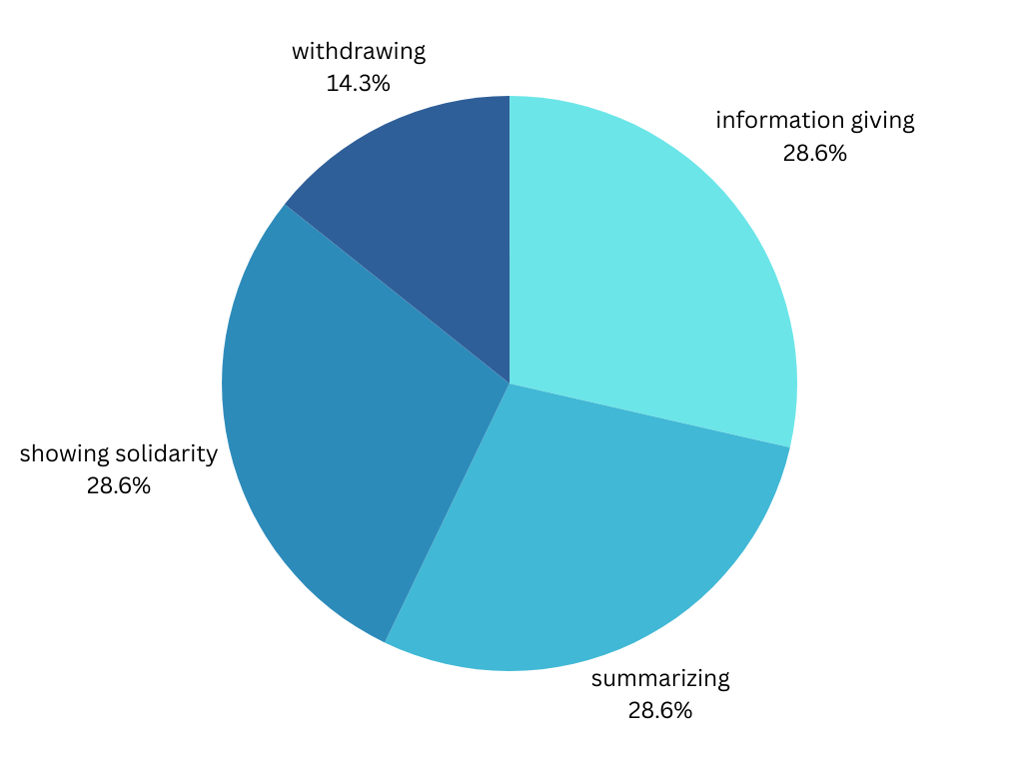
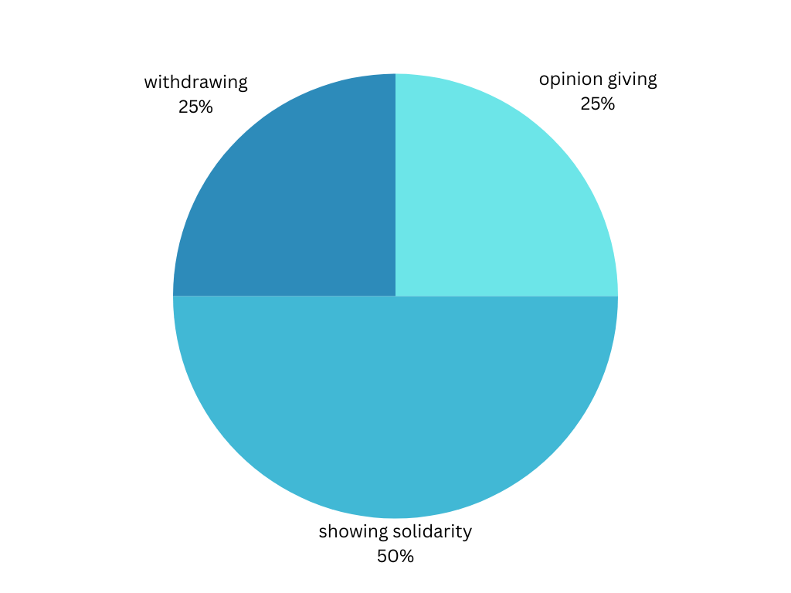
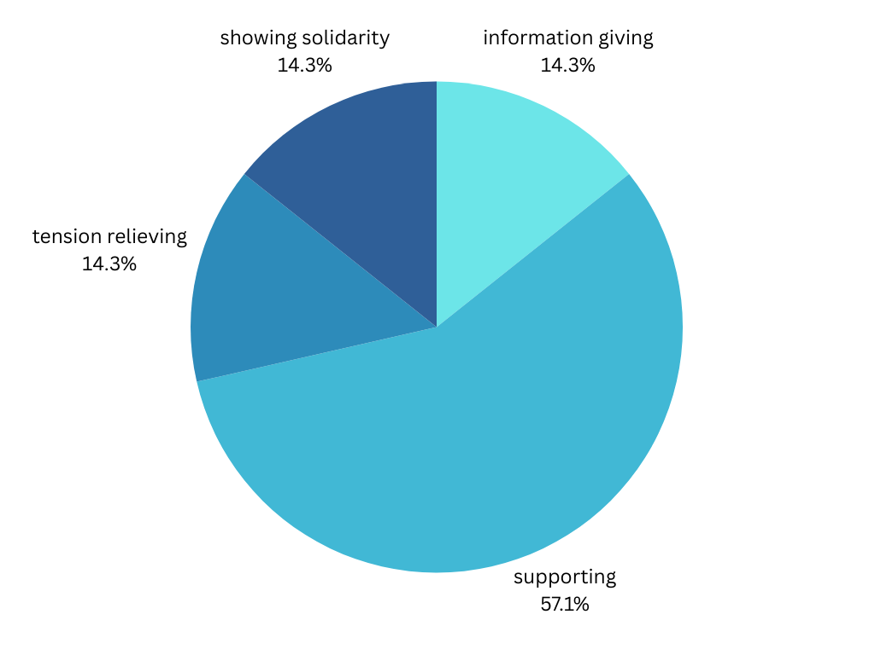
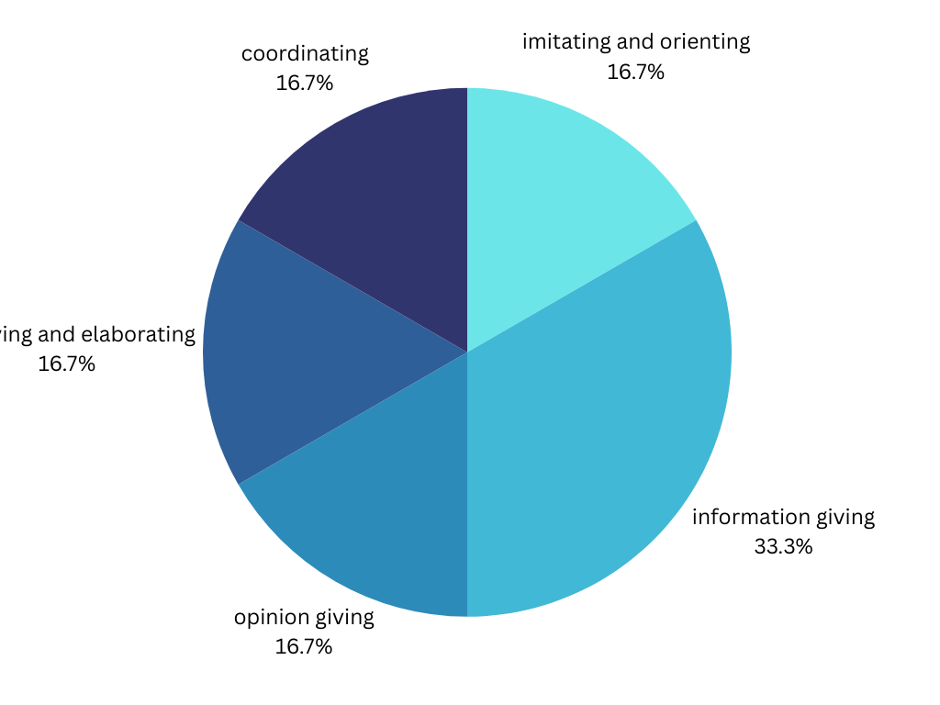
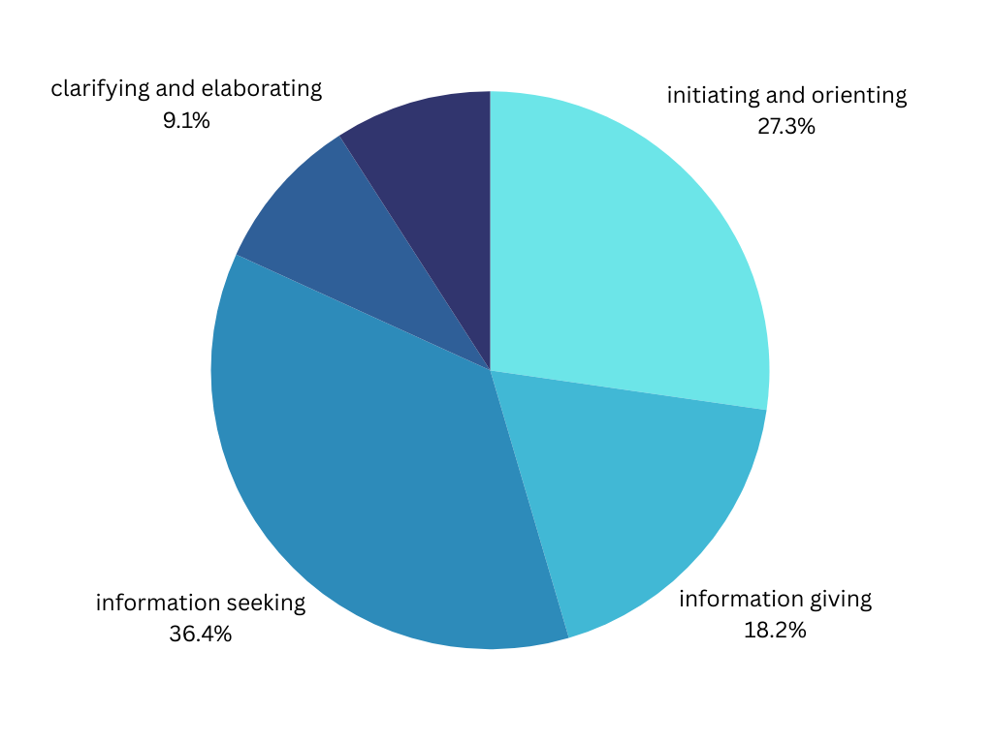
End behavioral Function Charts
Chris
Ryan
Durbie
Shellby
Maggie

Slide 23
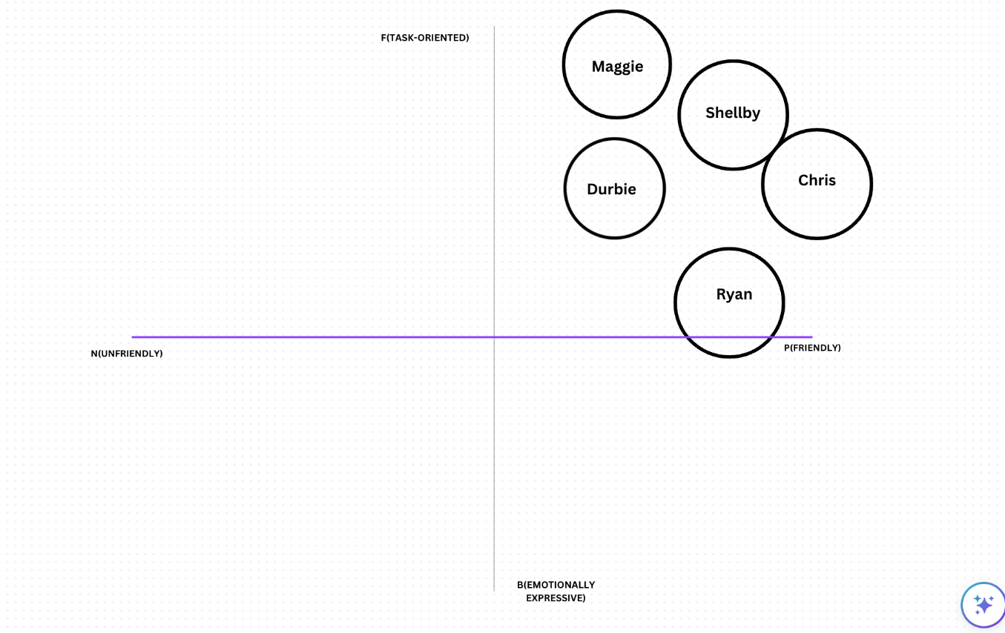
Beginning SYMLOG

Slide 24
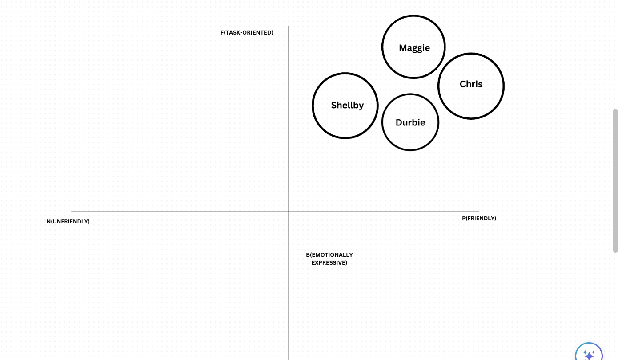
Middle SYMLOG

Slide 25
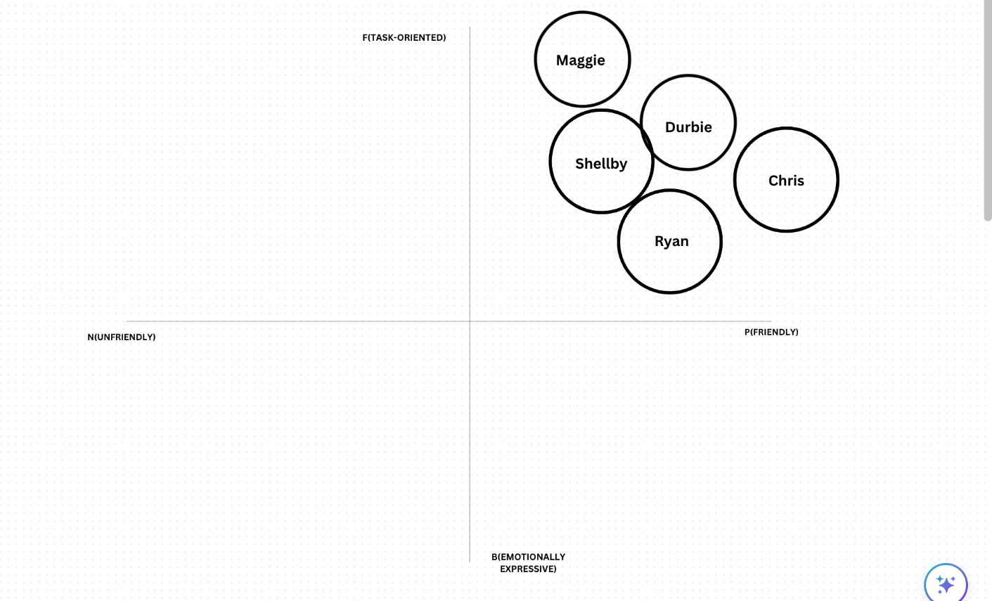
Beginning SYMLOG

Slide 26
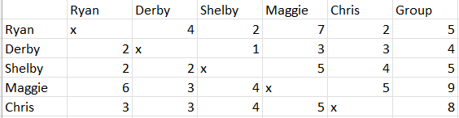
VID 1

Slide 27
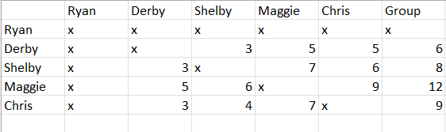
VID 2

Slide 28
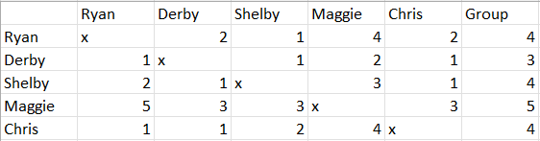
VID 3

Slide 29
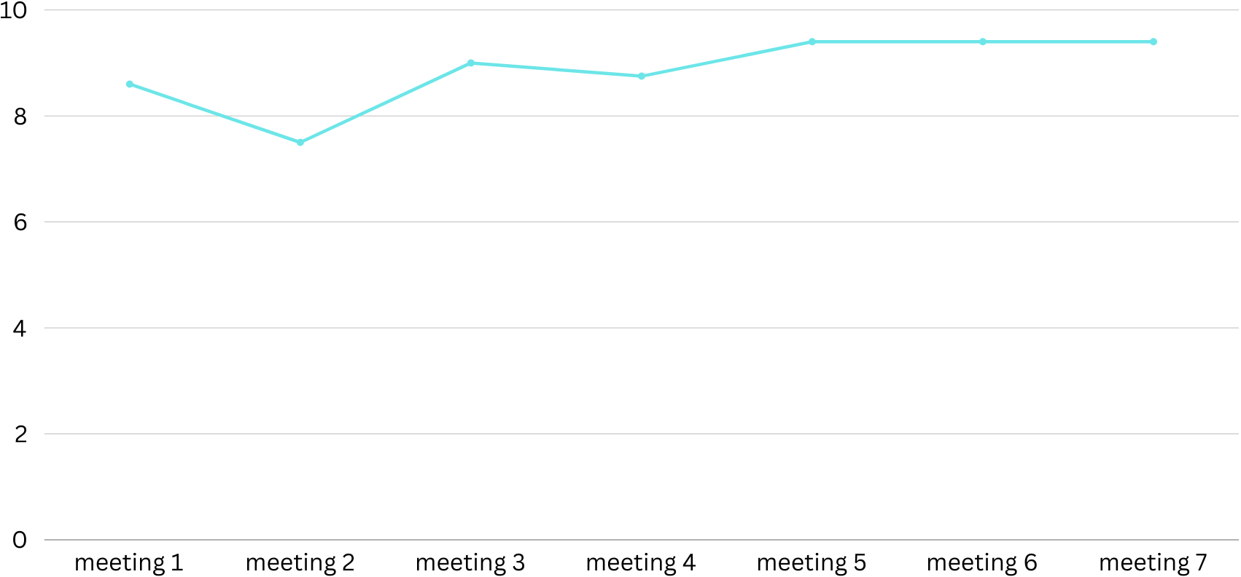
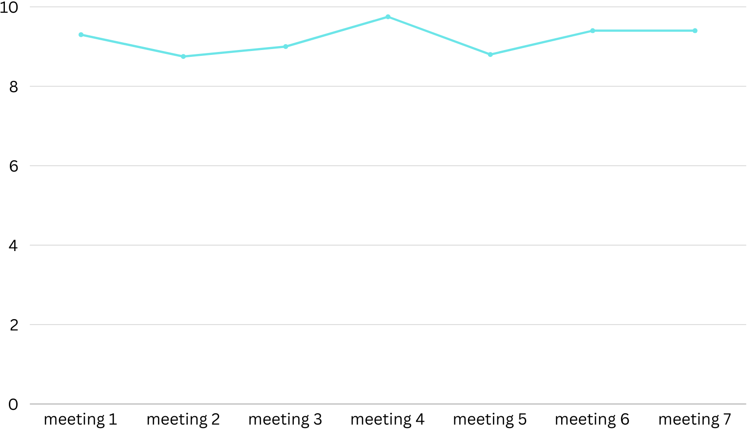
PMR Charts
Opportunity to speak
Adequacy of communication

Slide 30
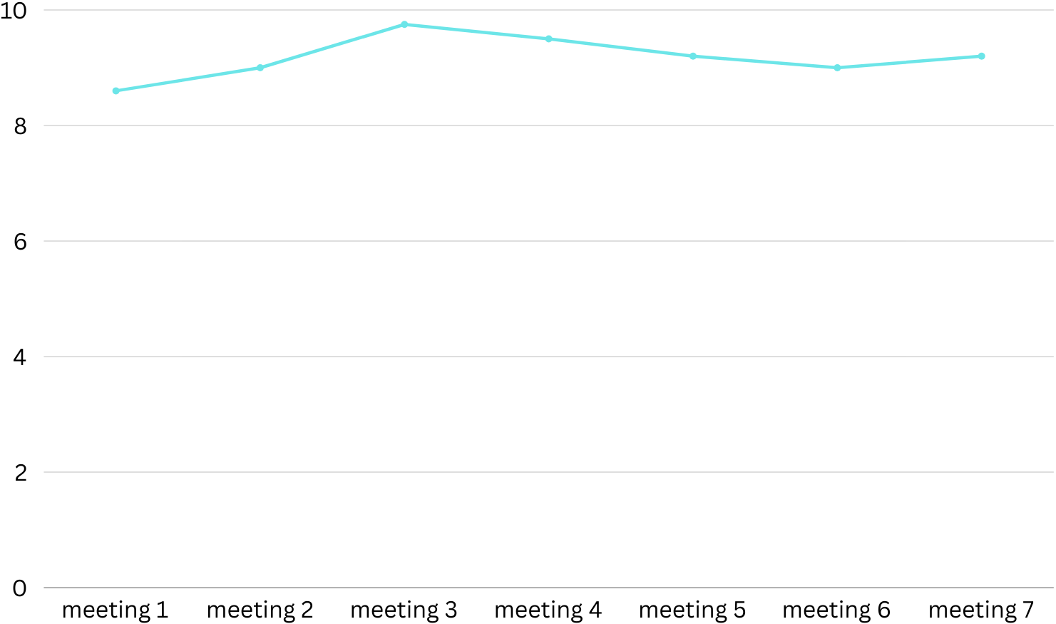
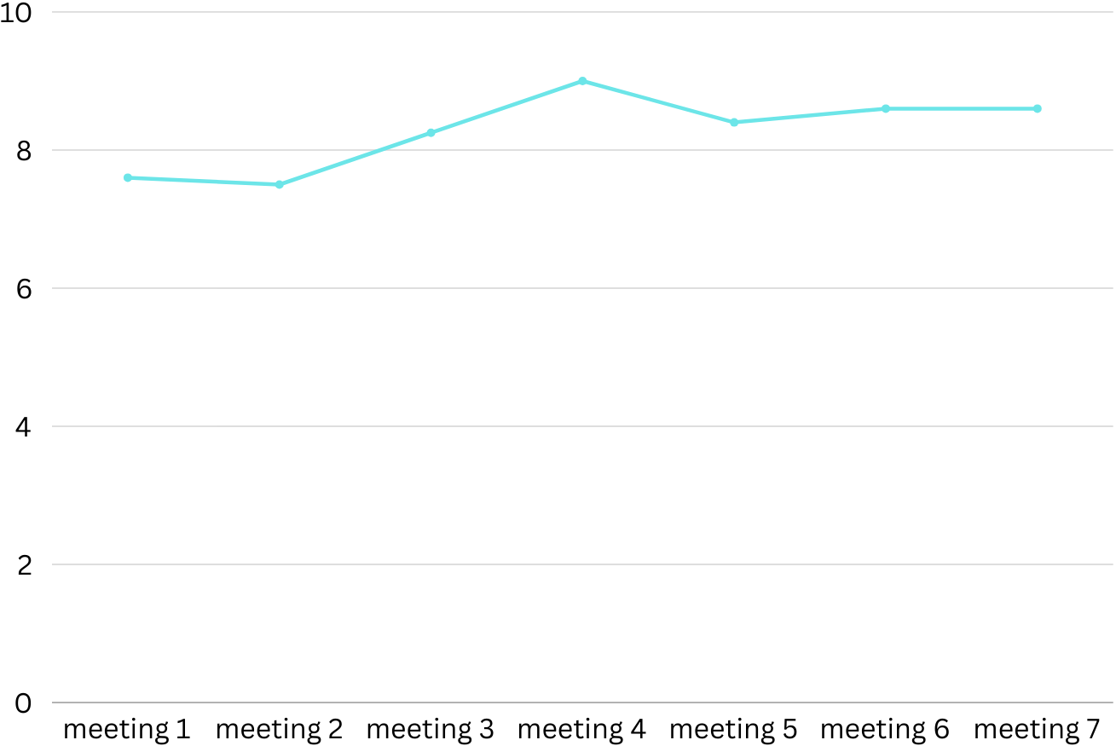
Interpersonal relations
Climate of acceptance

Slide 31
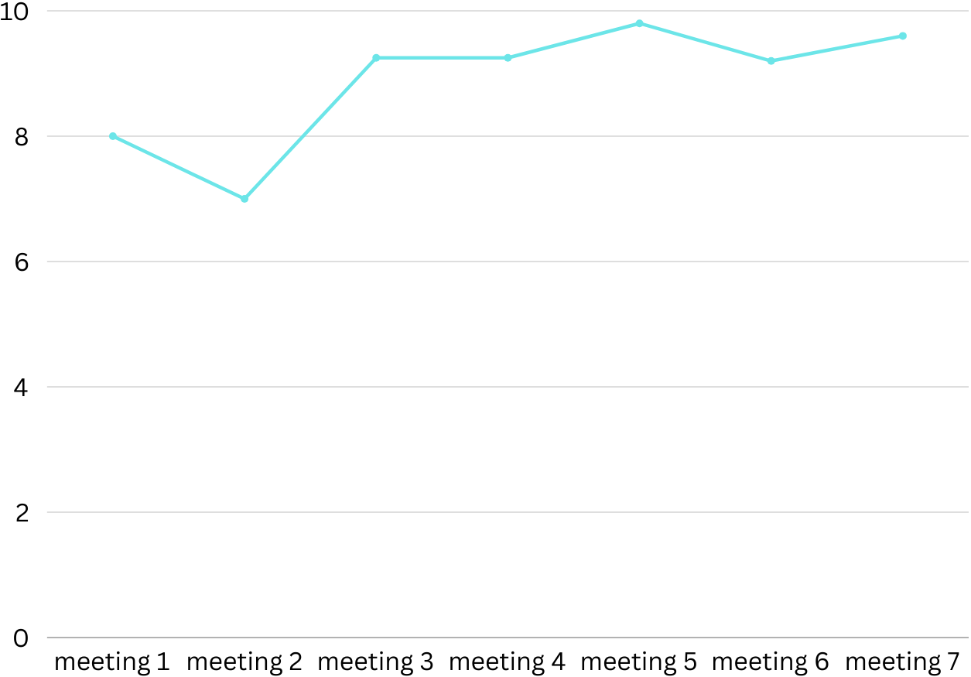
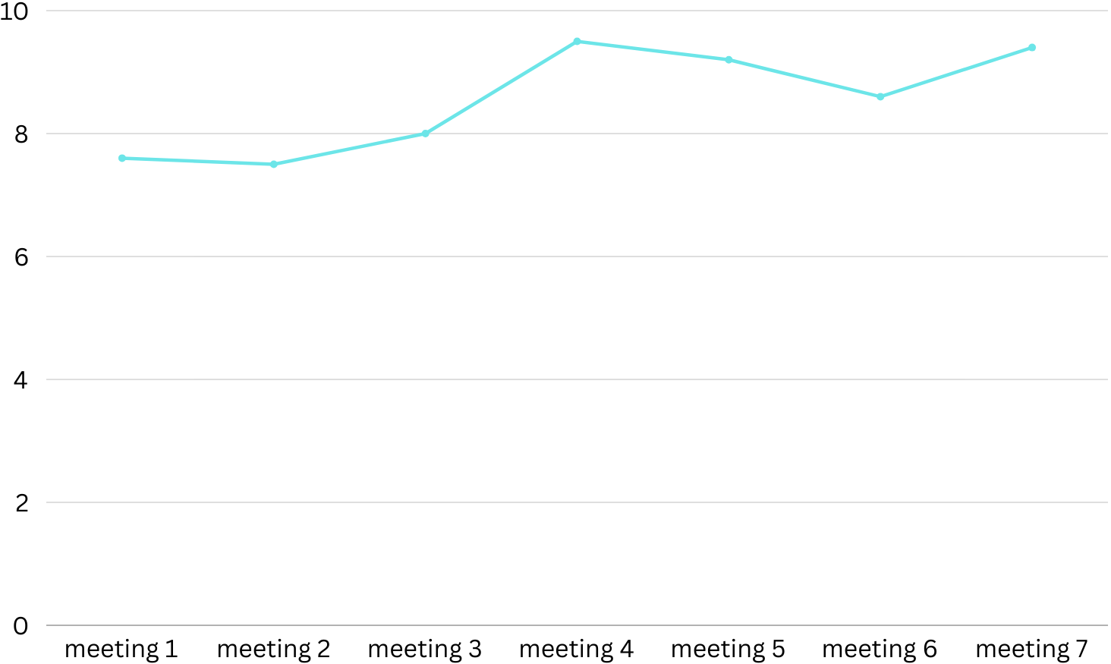
Satisfaction with personal role
Leadership

Slide 32
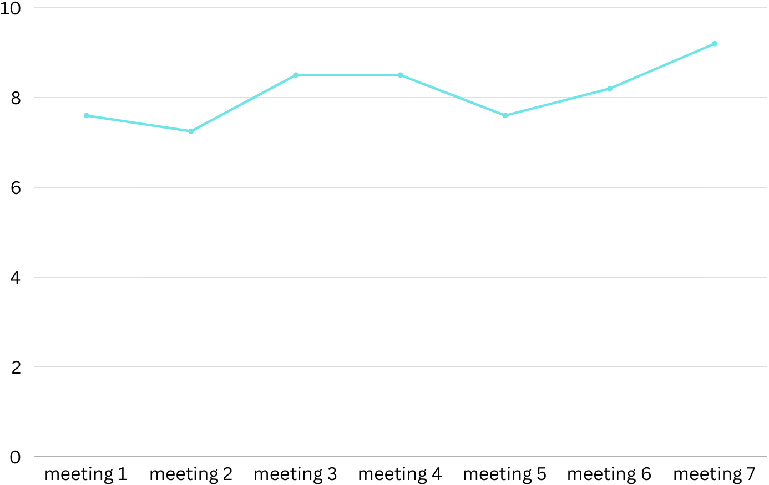
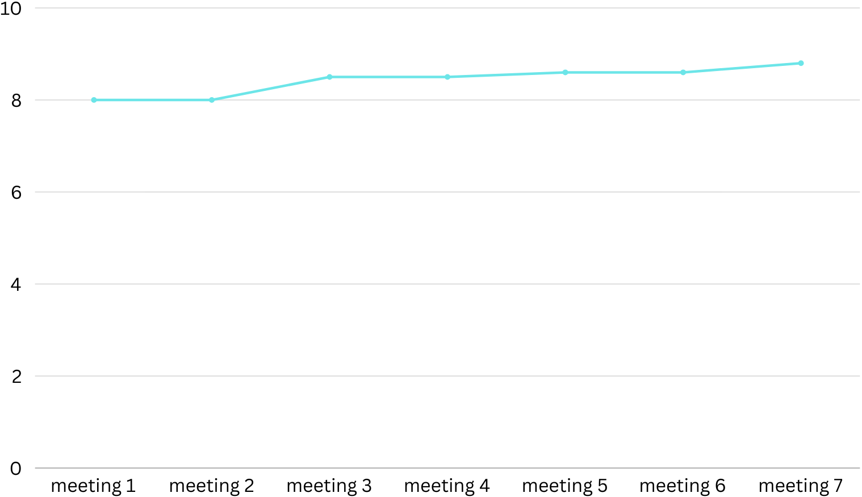
Overall
Quality of product

Slide 33
Recommendation
Worked hard overall
A lot of agreement
Worked through different ideas
Majority could always meet
Notes:
We had this time we had 3 meetings

Slide 34
?? Questions ??

